Slide 1
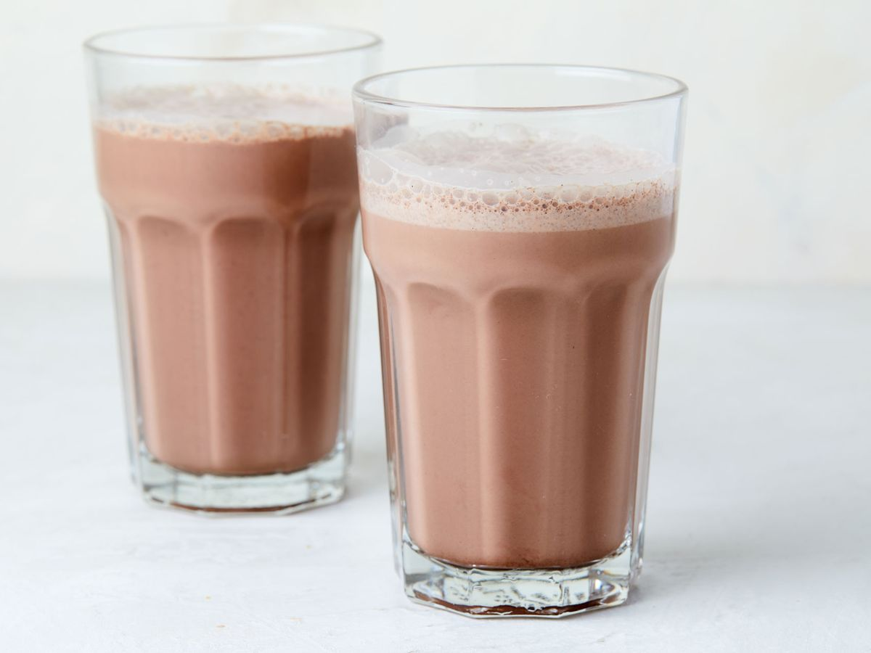
Got milk
Drink it!!! Drink it!!! Drink it!!!

Slide 2
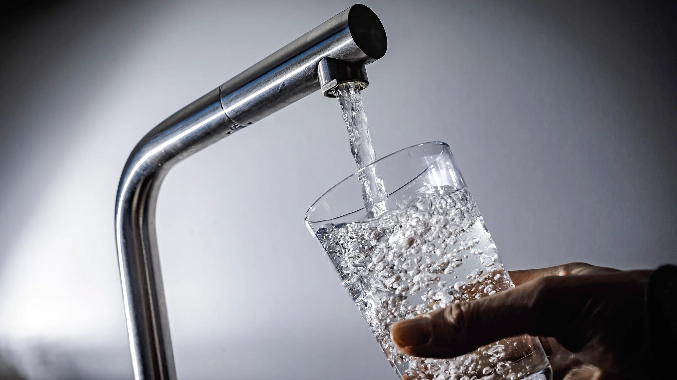
water
Good for you

